Slide 1
Welcome

Slide 2
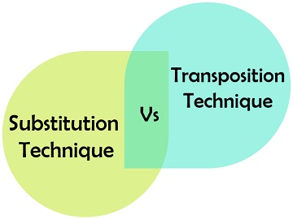
Difference Between substitution CIPHER and Transportation Cipher
Presented By---SHILPa Biswas

Slide 3
PLAIN TEXT
SUBSTITUTION OR TRANSPORTATION TECHNIQUE
CIPHER TEXT
Substitution technique and transposition technique are the fundamental methods of conversion the plaintext message to acquire the respective cipher text. These two methods are the basic building blocks of the encryption techniques and can also be used together, which is called a product cipher.

Slide 4
Difference between Substitution cipher and transportation cipher
In case of substitution technique it substitutes the letters of the plaintext from other letters, number and symbols.
On the other hand, the transposition techniques do not replace the letter, instead changes the position of the symbol.

Slide 5
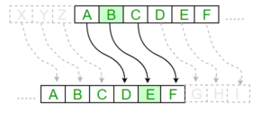
Example of Substitution cipher ------
Special case of Substitution cipher is known as Caesar cipher where the key is taken as 3.
The encryption can be represented using modular arithmetic by first transforming the letters into numbers, according to the scheme, A = 0, B = 1,…, Z = 25. Encryption of a letter by a shift n can be described mathematically as.
For Encryption,
Ex = (x + n) mod 26
For Dencryption,
Dx = (x - n) mod 26
Algorithm for Substitution Cipher: Input:
A String of both lower and upper case letters, called PlainText.
An Integer denoting the required key.
Plain Text: I am studying Data Encryption
Key: 4
Output: M eq wxyhCmrk Hexe IrgvCtxmsr

Slide 6
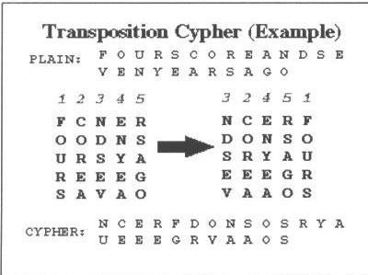

Slide 7
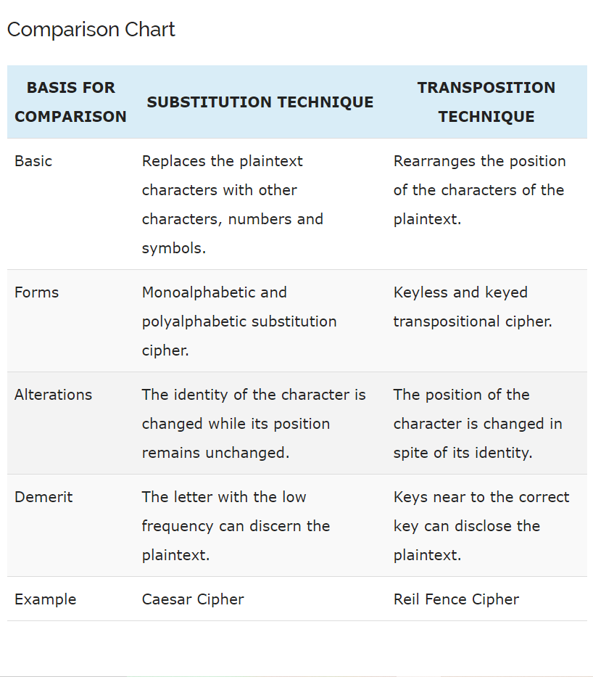

Slide 8
Thank you

